Slide 1
Writing workshop | finding the red thread
Julius Welzel
Kiel, 22nd June 2020

Slide 2
Paper ideas
Quantitative gait parameters from sensor-based movement analyses as progression markers in idiopathic Parkinson's syndrome
Towards a unified placement system for motion capture using inertial measurement units

Slide 3
Gait and IPD
Current research working on the idiopathic Parkinson's syndrome (IPS) is increasingly concerned with the identification of objective and specific markers to reliably make statements about therapy success and disease progression. Clinical routines are using mostly semi-quantitative procedures such as the Unified Parkinson's Disease Rating Scale of the Movement Disorder Society (MDS-UPDRS). Quantitative gait parameters from sensor units (Internal Measurement Unit, IMU) can give an objective, cost-effective alternative. This work aims to find quantitative sensor markers from supervised movement tasks, to make reliable statements about disease progression. Data from two independent cohorts were combined to make findings more reliable. In a multivariate linear regression model, we find step length and task duration can predict MDS-UPDRS-III subscores and disease duration respectively during a 20m straight walk. This relationship does not hold for step time variability. Additionally, we find different effects on the number of steps in a circular walk paradigm, depending on the direction of rotation if one bodyside is more effected by the IPS. The results show the importance of carefully assessing quantitative gait parameters to make assumptions about disease progression. Results should help to guide the progress of identifying valid markers across different stages of IPD using a meaningful combination of task and parameter.
Wendtland ea., Nature, 2020

Slide 4
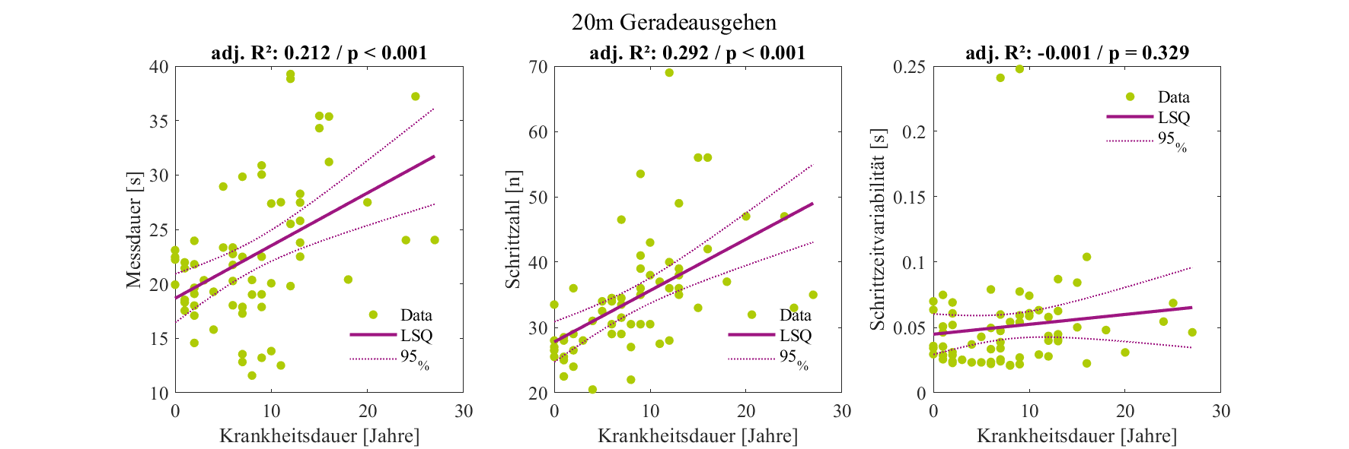
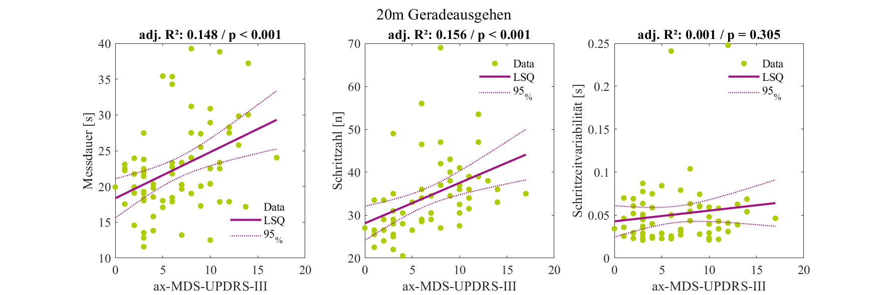
20 m straight

Slide 5
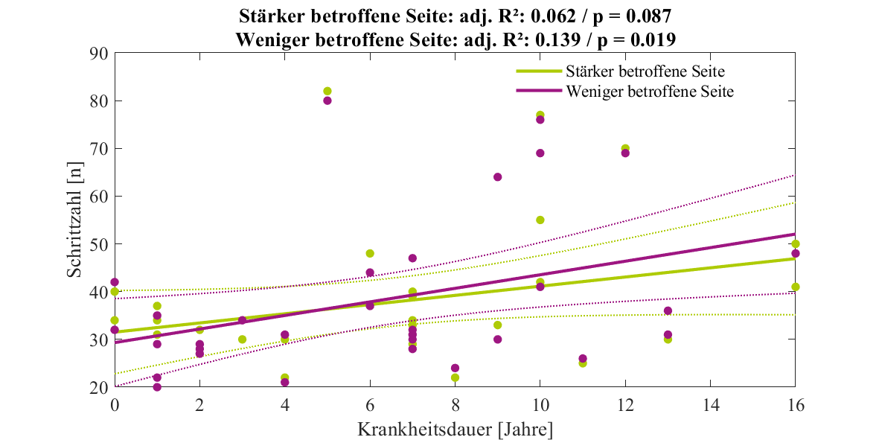
Circular walk

Slide 7
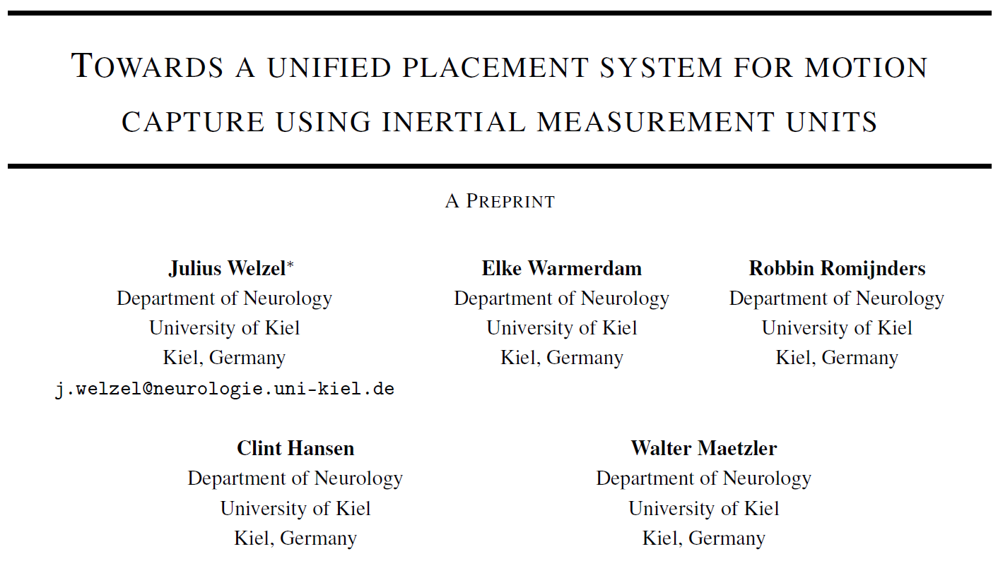
Sensor placement

Slide 8
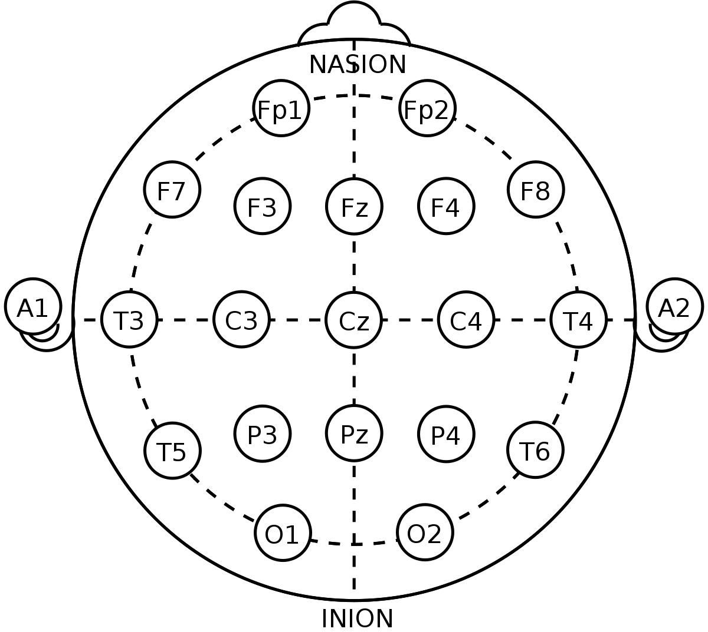
idea
As early as the first International EEG congress, held in London in 1947, it was recognized that a standard method of placement of electrodes used in electroencephalography (EEG) was needed. Possible methods to standardize elec- trode placement were studied by H.H. Jasper, which resulted in the definition of the 10±20 electrode system (Jasper, 1958). Since then, the 10±20 electrode system has become the de facto standard for clinical EEG. It has also proven to be very useful in the study of event-related potentials (ERPs) in non-clinical settings.

Slide 9
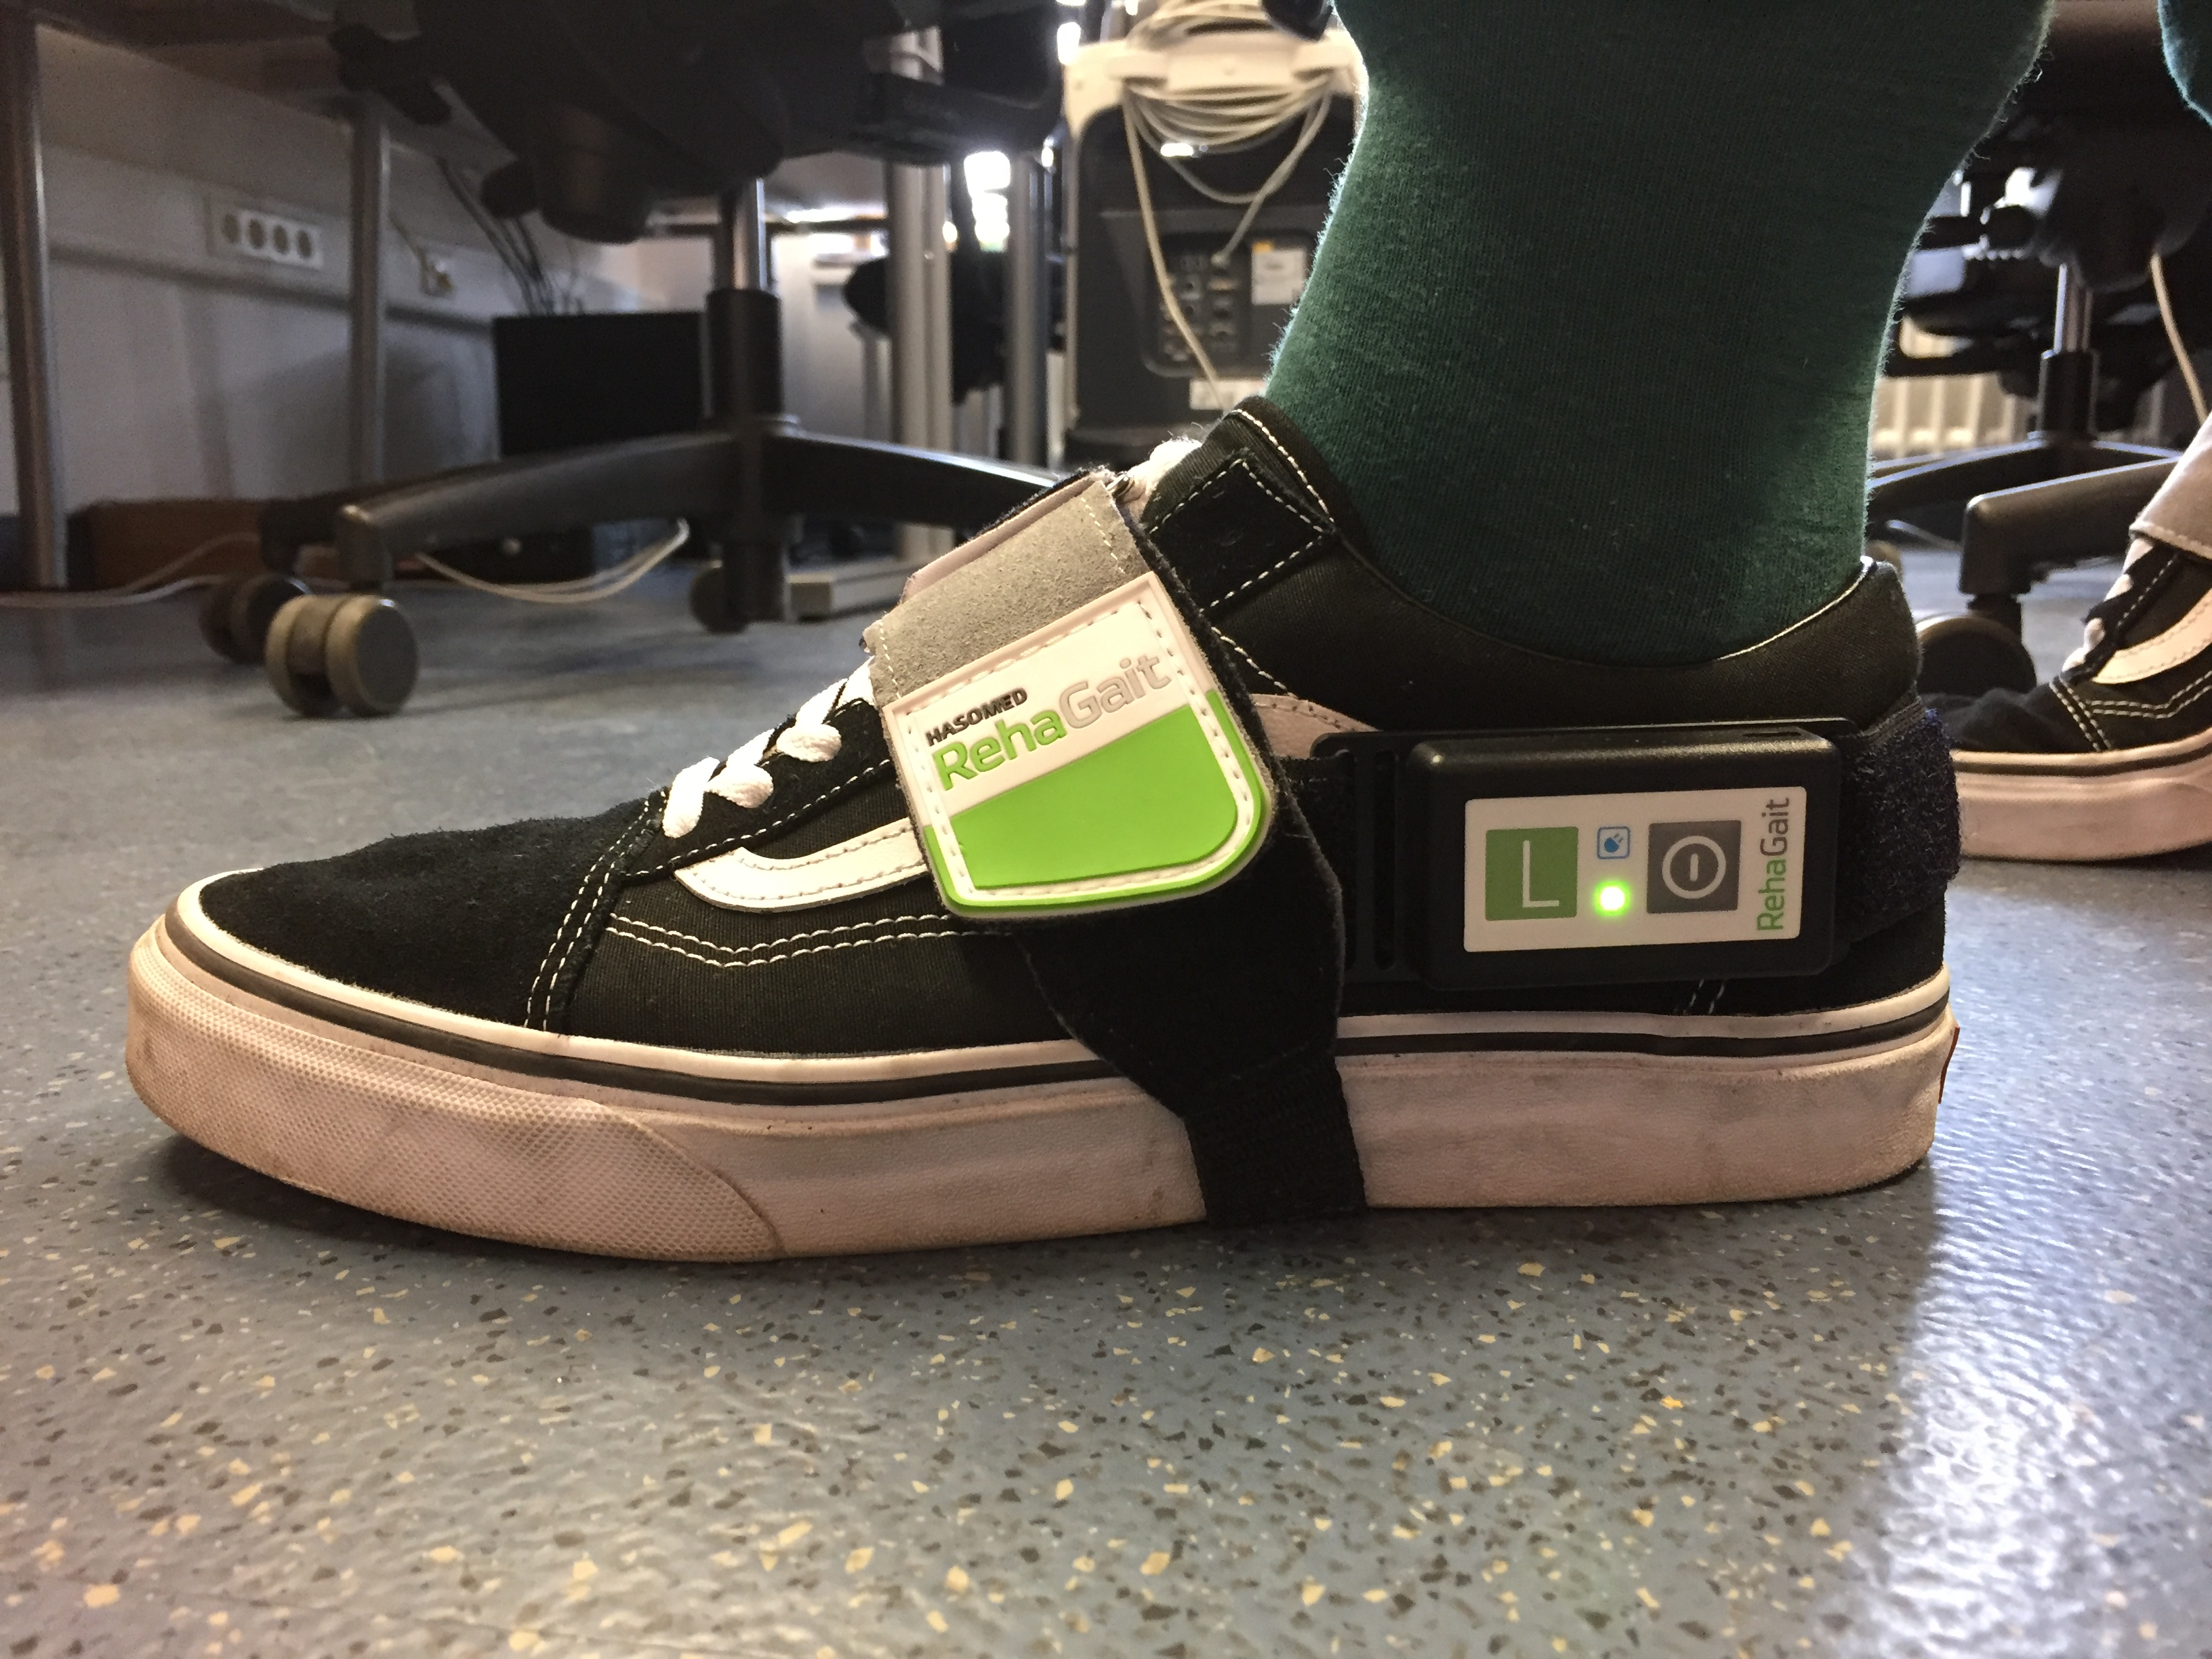
10-20 system for imus?
Numeric code
Position
Orientation
5.3-021-000.000.000

Slide 10
Reference spaces
GLOBAL SPACE
LOCAL SPACE
ROTATION SPACE

Slide 11
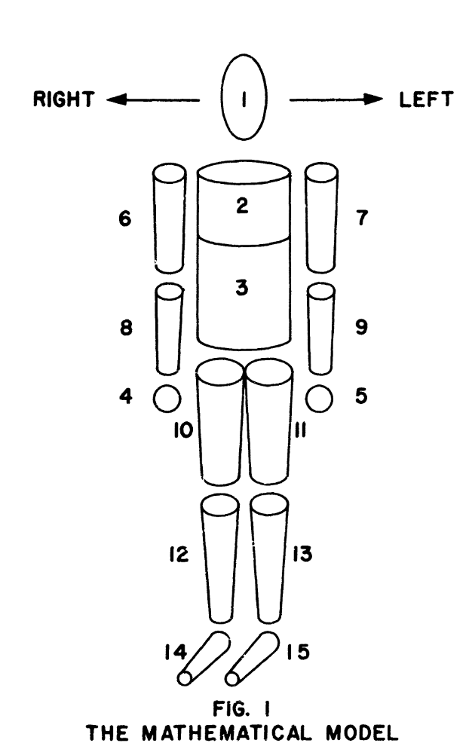

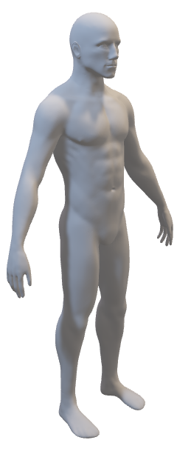
GLOBAL space
z
0.0
2.1
1.1
3.1
2.N
3.N
2.2
1.2
3.2
2.3
3.3
y
4.1
5.1
4.N
5.N
4.2
5.2
4.3
5.3
x
Hanavan, 1964

Slide 12
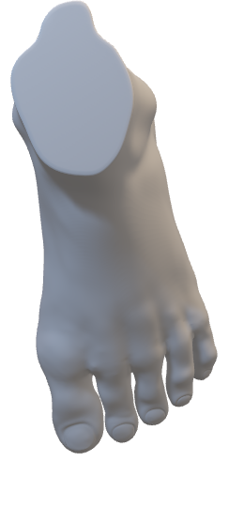
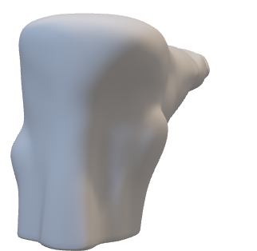
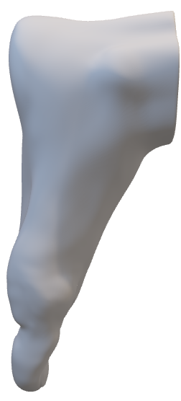
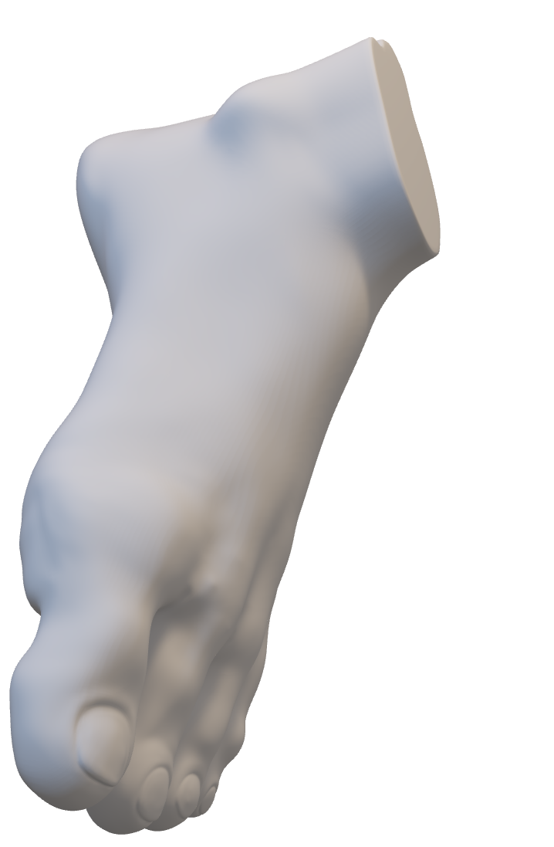
Local space
2
z
1
0.0
0
0
1
2
x
2
2.1
1.1
3.1
2.N-xyz
3.N-xyz
2
y
z
2
1
2.2
3.2
z
1.2
1
0
0
0
2.3
3.3
0
0
1
2
y
4.1
5.1
1
2
x
4.N-xyz
5.N-xyz
x
2
4.2
5.2
1
4.3
5.3
y
0
2
1
0

Slide 13
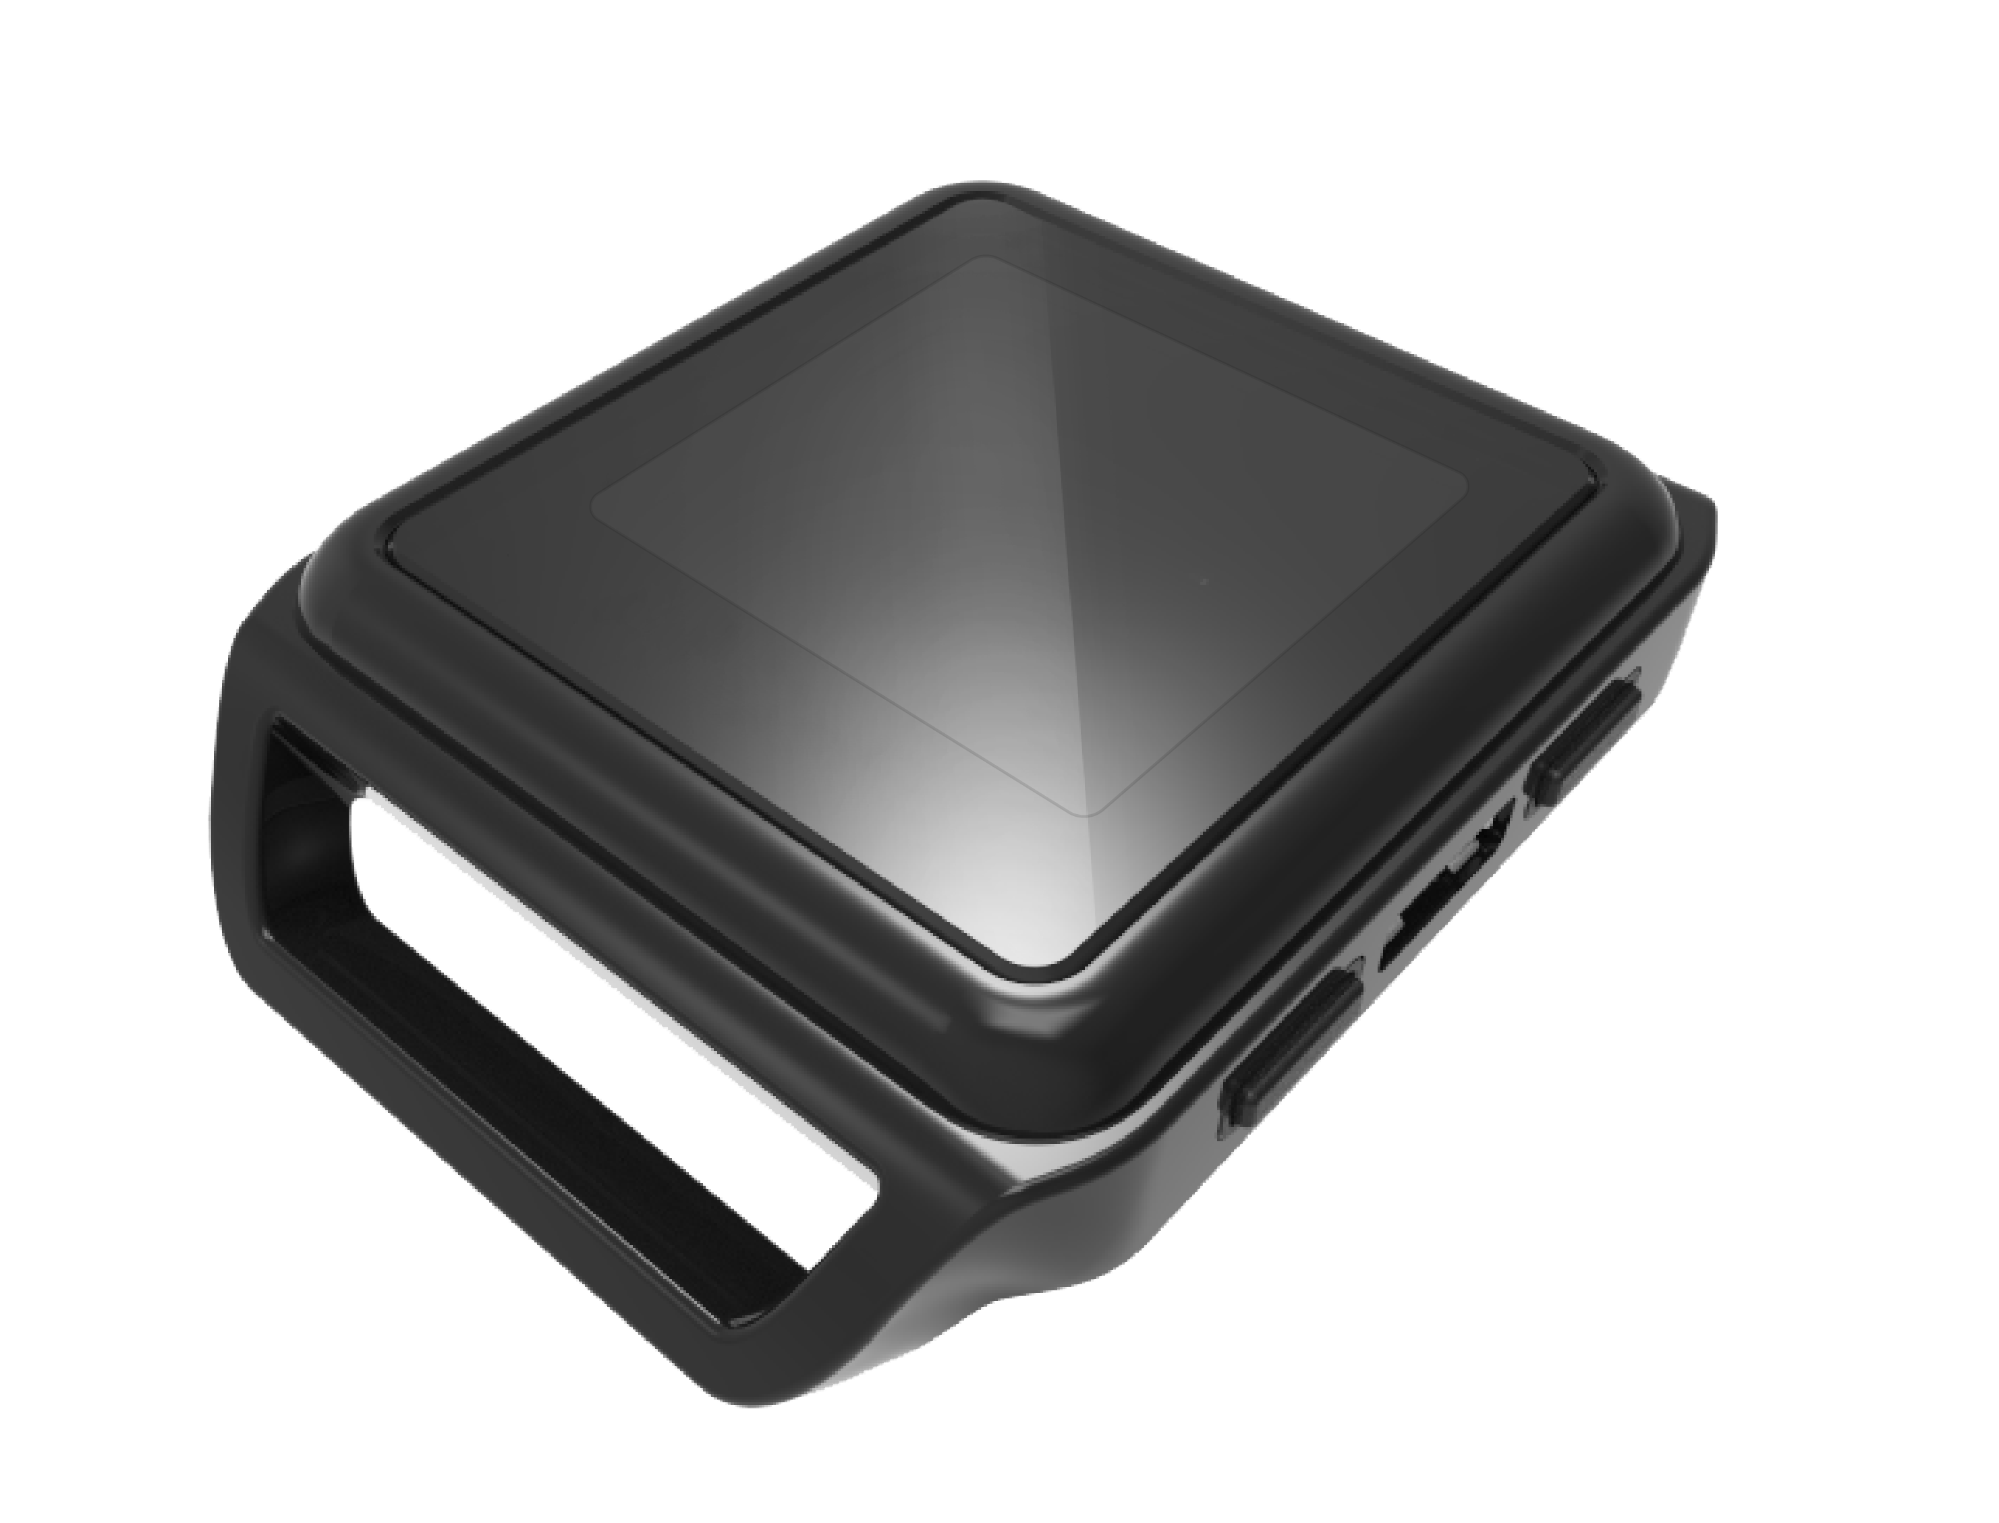
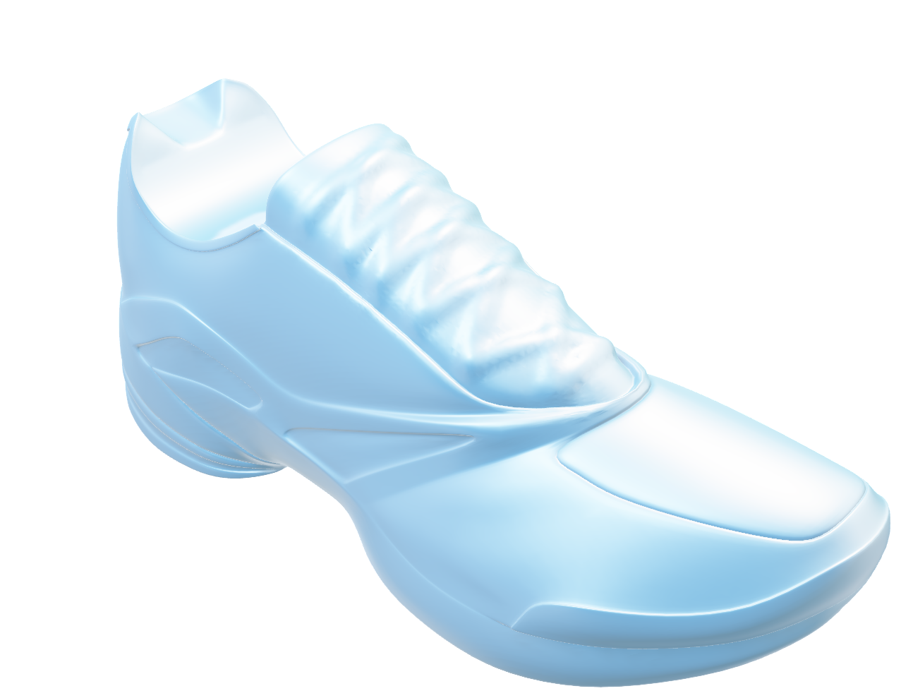



First test
2
2
y
z
1
0
1
4.1
x
2
M.N-xyz
4.2
4.3
4.3-212

Slide 14
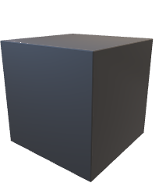


Rotation space
y
z
y
z
y
z
x
x
x_{rs} to y_{rs} to xy-plane_{loc}
y_{rs} to x_{rs} to yx-plane_{loc} & z _{rot} » z _{loc}
z_{rs} to y_{rs} to zy-plane_{loc}
_{→ 090.010.090}
x

Slide 15
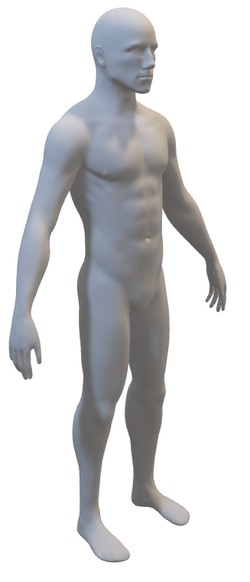


final
M_{gs}.N_{gs}-xzy_{ls}-x_{rs}y_{rs}z_{rs}

Slide 16
Data orga mocap
Recording meta data
Stream meta data
Recording
Study
ID
Task
Date
Time
Place
Comments
Subject
ID
Age
Height
Weight
Handedness
Vision
ICD
Datastream
Type of Stream
Names of Stream
Location of Stream
Timestamps
Sampling rate
Units (SI)
Device
Manufacture Model
UDID
Props
Online Processing
Filters
Corrections

Slide 18
Data visualisation
Resources
Fundamentals of Data Visualization – book (https://serialmentor.com/dataviz/)
Graph gallery - website
(https://www.r-graph-gallery.com/)
Plot single subject data

